Slide 1
Apportionment, redistricting
& Gerrymandering
DO NOW: Answer the following questions to the best of your ability:
Why do we have censes every ten years? What purpose do they serve?

Slide 2
The U.S. Census
…is a decennial census mandated by Article I, Sec. 2 of the U.S. Constitution: “Representatives… shall be apportioned among the several States which may be included within this Union, according to their respective Numbers…”
“Reapportionment”
“…the process by which seats in the U.S. House of Reps are redistributed throughout the 50 states following each U.S. census.”

Slide 3
“What happens with all this new information on the U.S. population every 10 years?”
If a state GAINS or LOSES representation in the House, that state must redraw its Congressional Districts to account for changes in population
“Redistricting”
“What is redistricting?”
Redistricting is the way in which we ADJUST THE ELECTORAL DISTRICTS that determine who represent us (in this case, Congressional Districts).

Slide 4
"Apportionment” is the process of dividing the 435 memberships, or seats, in the House of Representatives among the 50 states based on the population figures collected during the decennial census and using a complex mathematical formula.

Slide 5
2010 CENSUS RESULTS & DATA

Slide 7
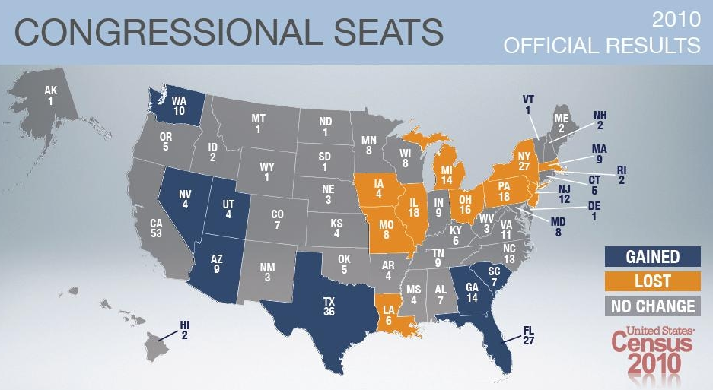

Slide 8
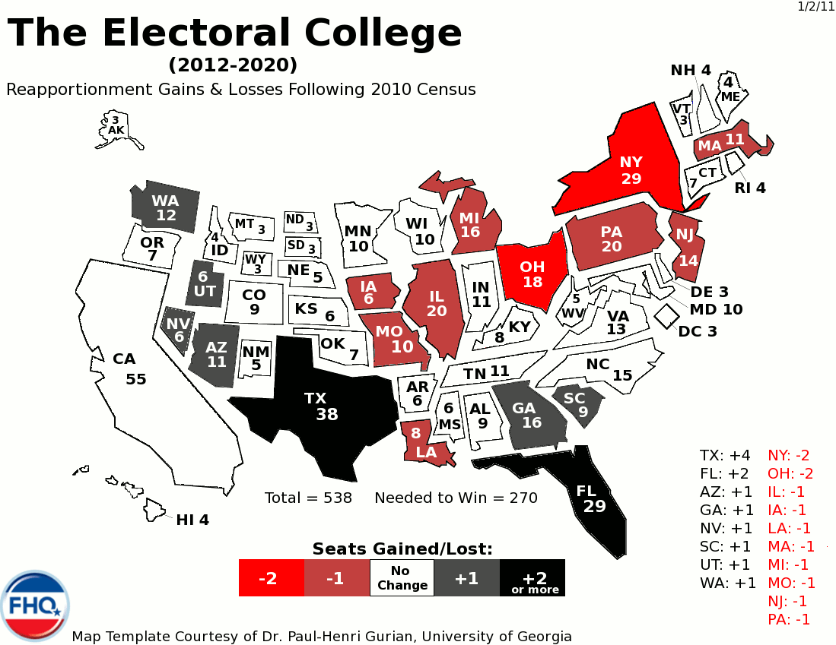

Slide 9
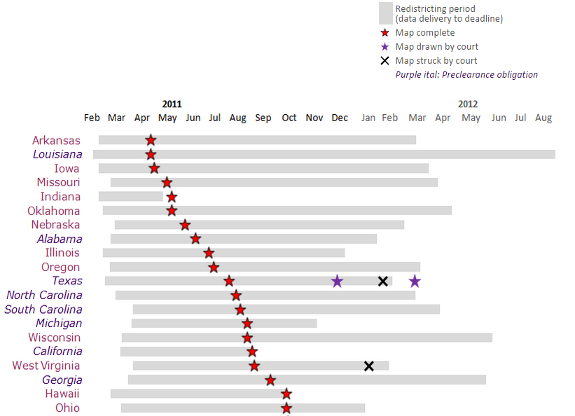
“When is redistricting?”
1.) CENSUS DATA delivered to OH in March 2011
2.) OHIO GENERAL ASSEMBLY completed C.D. maps by October 2011

Slide 10
“WHO does the redistricting?”
“ADVISORY COMMISSION”
6-MEMBER ADVISORY COMMISSION is selected by the state Senate and state House majority leaders (3 each), at least one of whom must be from a different party, and at least one of whom must not be a legislator.

Slide 11
“WHO does the redistricting?”
IN OTHER WORDS:
If both the State Senate and the State Assembly (State House) are of the same party they can make the “6-MEMBER ADVISORY COMMISSION” consist of 4 members of their own party and only two members of the opposing party. This gives the majority party in the State government control over how the congressional boundaries are drawn.

Slide 12
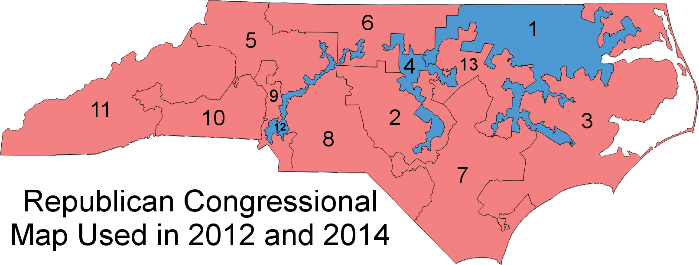
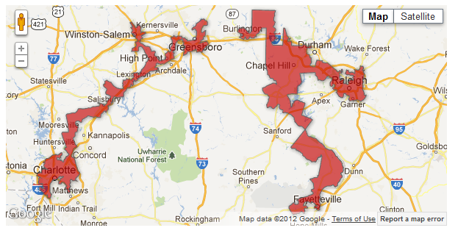

Slide 13
https://youtu.be/Mky11UJb9AY

Slide 14
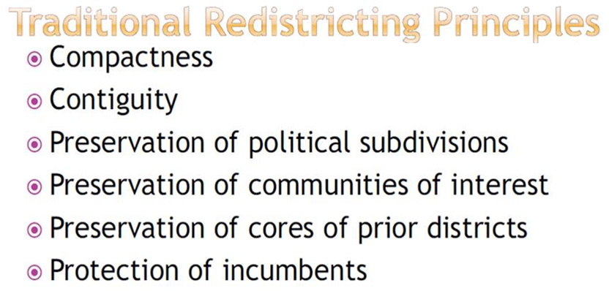
“WHERE/HOW is redistricting done?”
(rule for drawing Congressional Districts)
“Like all states, Ohio must comply with constitutional equal population requirements & with section 2 of the VOTING RIGHTS ACT… Ohio law further requires that state legislative districts be CONTIGUOUS & COMPACT. Districts must preserve whole political units – counties, townships, municipalities, and wards, in that order – WHERE FEASIBLE.”

Slide 15
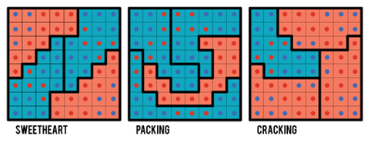
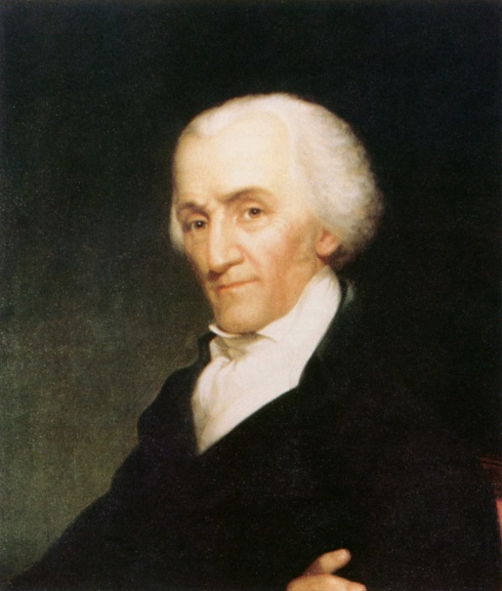
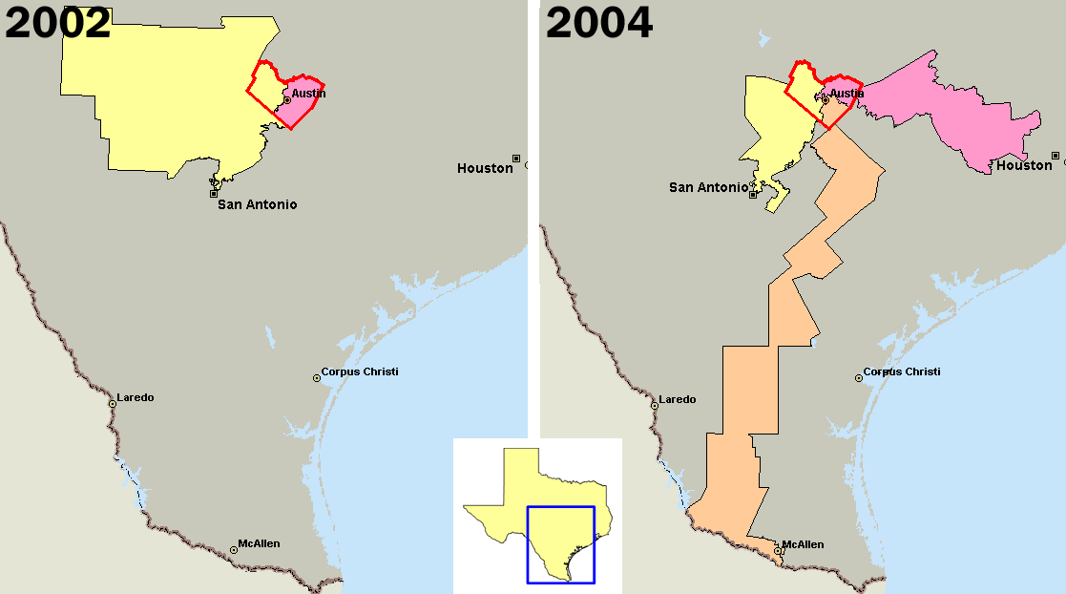
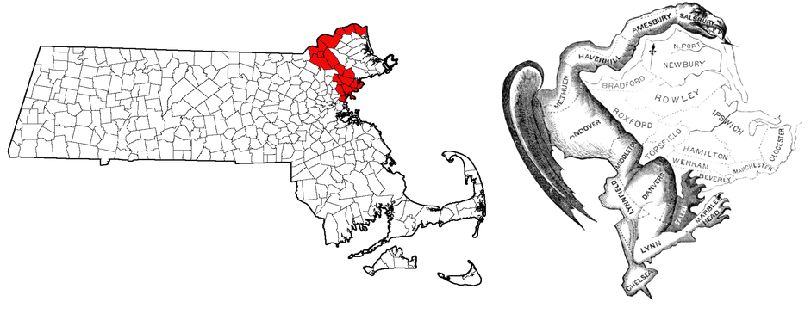
“What is Gerrymandering?”
In the process of creating electoral districts, GERRYMANDERING “is a practice that attempts to establish a POLITICAL ADVANTAGE for a particular PARTY or GROUP by MANIPULATING DISTRICT BOUNDARIES to create partisan advantaged districts.” (Racial & Incumbent)

Slide 16
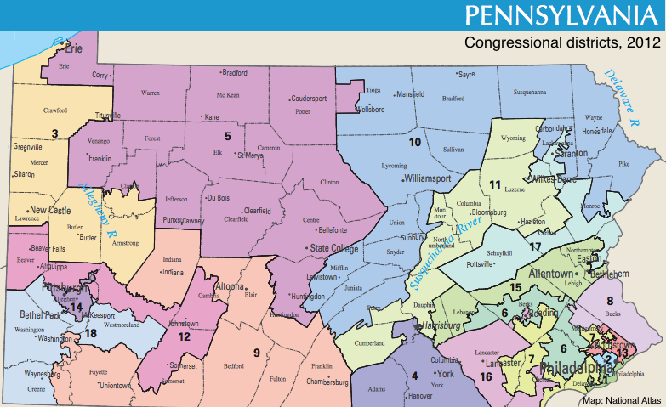
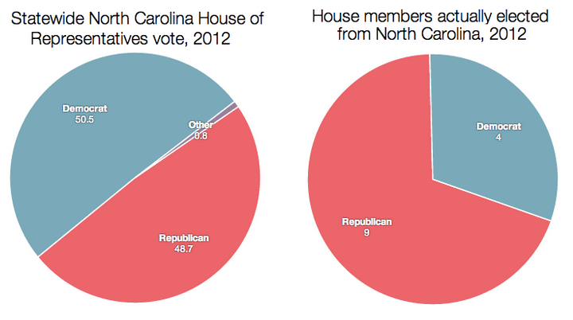
“PARTISAN GERRYMANDERING”
…occurs when the map-drawing process is intentionally used to benefit a particular political party — to help that party win more seats in the legislature, or more easily protect the ones it has.
THE GOAL:
“Create districts that will elect members of one party & only a few that will elect members of the other party!”

Slide 17
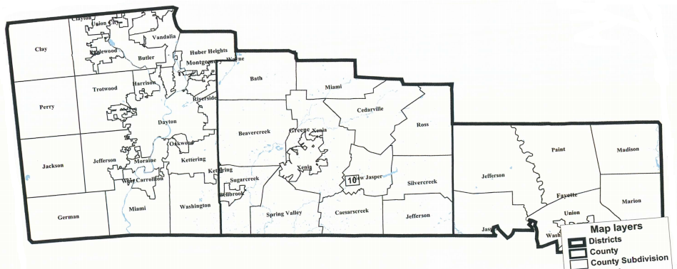
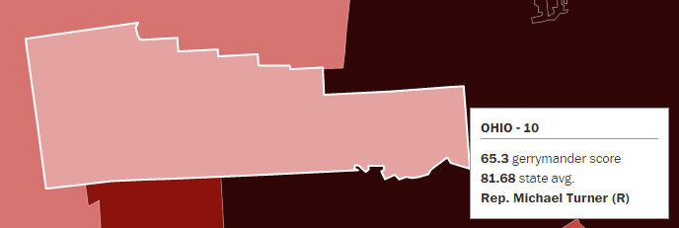

Slide 18
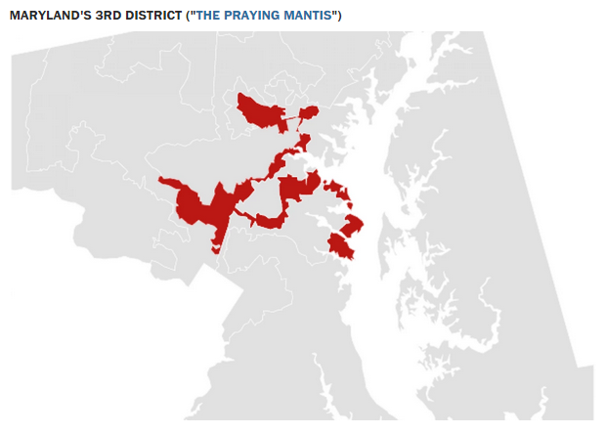
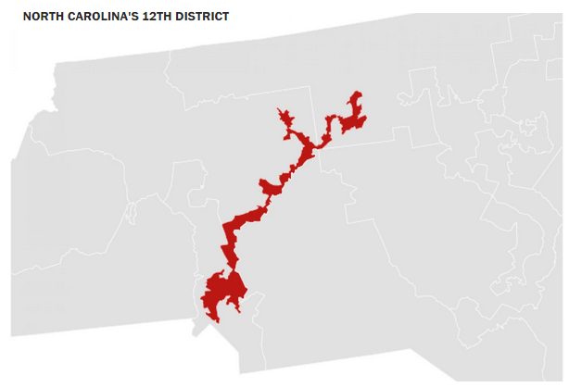
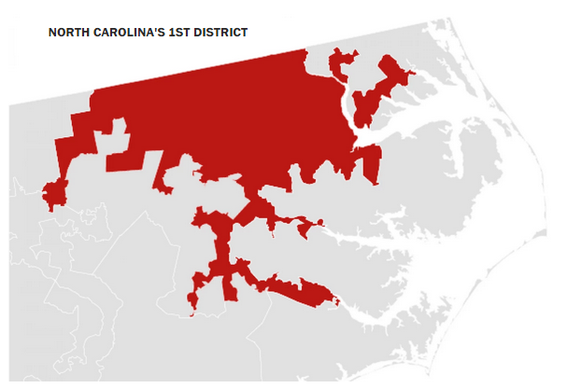
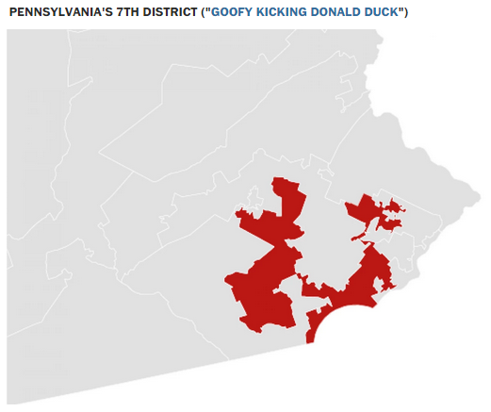
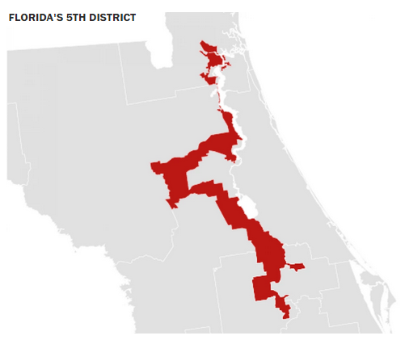

Slide 19
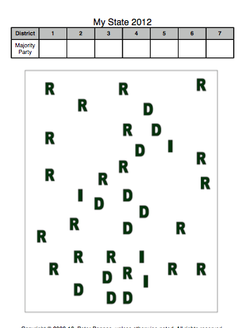
DEMOCRATS
REPUBLICANS

